Slide 1
Yes, you CAN…
…use the controller area network in non-automotive applications
Randy glenn
Supercon 2024

Slide 2
What this presentation is
A brief introduction to CAN hardware
A brief introduction to CAN libraries
Enough to whet your appetite and get you to try this technology
NOT a comprehensive look at the technology
NOT covering CANFD or anything new like that
NOT covering CANopen

Slide 3
What is CAN?
Controller Area Network
Automotive technology made by Bosch in the late 1980s
Included as part of the ODB-II standard in North America
Widely supported in both hardware and software

Slide 4
Where is CAN used?
Cars, to connect different systems and ECUs
Industrial Automation
Robotics
Aerospace
Pinball machines
Trains
Elevators
There are others

Slide 5
Who makes CAN?
Bosch developed the standard, ISO publishes it
Virtually every microcontroller manufacturer has CAN devices
Many SoCs have CAN support
Linux has support through SocketCAN
Python and NodeJS have support
Arduino, CircuitPython, MicroPython, C APIs…
CAN controllers for devices that don’t support it are available from Microchip and others

Slide 6
Why should I use CAN?
Differential bus → Resists electrical noise
Built-in addressing → Protocol headaches are handled
Has error checking and retransmission → Protocol headaches are handled
Wide industry support → Lots of parts from many suppliers
Linux support built in → Easy to interface to bigger systems
Tools available → You can debug your system
Cheap
Safe and legal thrill

Slide 7
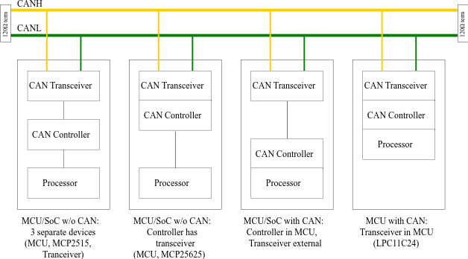
How does CAN work?

Slide 8

How does CAN work?
Nodes transmit frames
Four types of frame: Message, RTR, Error, Control
Message contains up to 8 bytes of data
RTR is a request to send a Message
Frames have an identifier, 11 bit or 29 bit, data length

Slide 9

How does CAN work?
Differential signalling. But a 1 is “recessive”, and 0 is “dominant”
So if one node sends a 0 and another sends a 1… 0 wins
Identifier is transmitted first
Nodes check state of the bus. If the state you’re driving doesn’t match what you’re seeing… collision. Node stops transmitting, waits for the frame to end
So the lowest identifier wins the collision, and keeps transmitting. Every other node waits for the frame to end and tries again.

Slide 10
How does CAN work?
When receiving a frame, the nodes check the CRC
The transmitting node sends a recessive state in ACK bit
If the CRC checks out, the other nodes send a recessive state in the ACK bit
So if no node receives properly, the transmitter knows to send again. But if any node receives properly, transmitter thinks it was transmitted fine.
If it wasn’t ACKed, retransmit. If you retransmit too many times, enter an error state.

Slide 11
Linux support
Linux has built-in support for CAN using SocketCAN
Can-utils package has cansend, candump, cansniffer...
Wireshark supports CAN
Python-can package adds support for Python
USB dongle like CANtact or CANable plus candlelight-gs firmware makes it easy
For Raspberry Pi, add a SPI to CAN bridge (MCP2515 supported out of the box)
Some support exists on Windows, but Linux is best supported

Slide 12
An example (contrived)
Halloween front door lighting effects
We have a doorbell for people to push
We want to avoid pranksters, so we’ll have a doormat sensor to see that they’re standing in front
We’ll have lighting
We’ll have sound effects

Slide 13
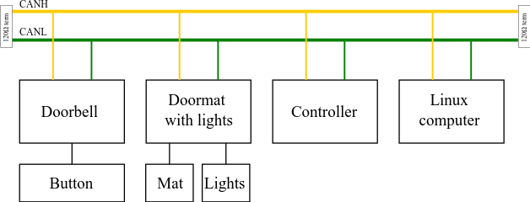
An example (contrived)

Slide 14
Messages in our example
Doorbell button state, 1 byte data, ID 0x200, sent on push
Doormat state, 1 byte data, ID 0x201, has to be requested
Do lighting effects, 1 byte data, ID 0x202, sent by controller
Do sound effects, 1 byte data, ID 0x203, sent by controller

Slide 15
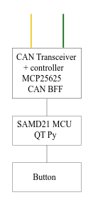
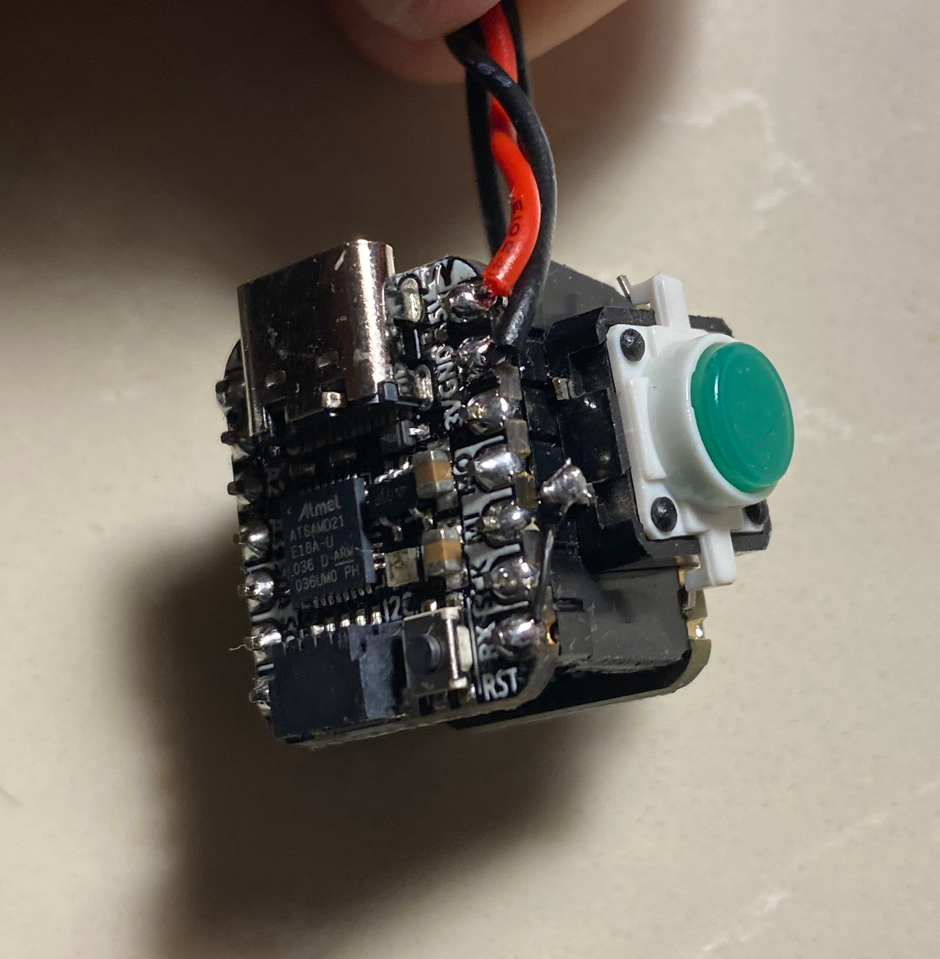
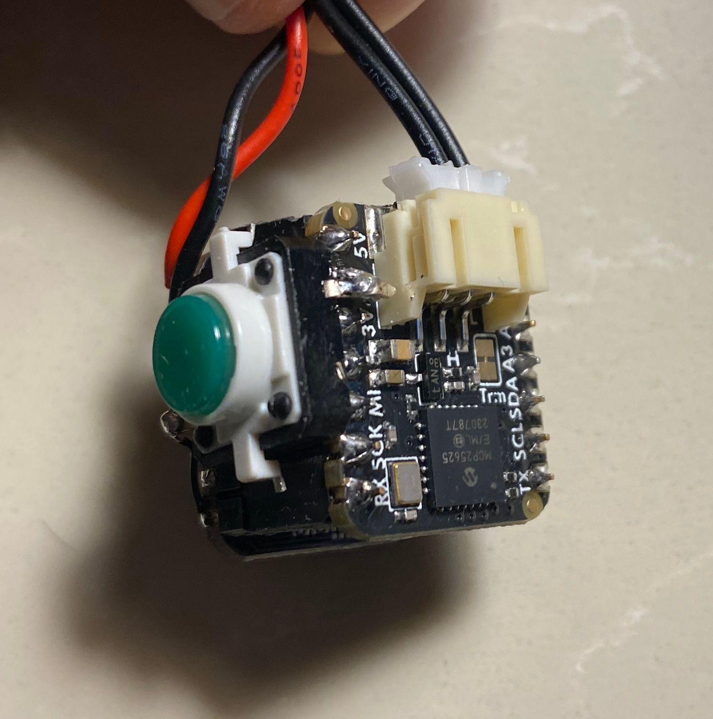
Doorbell
Using Adafruit QT Py with CAN BFF and Arduino environment
SAMD21 and MCP25625

Slide 16
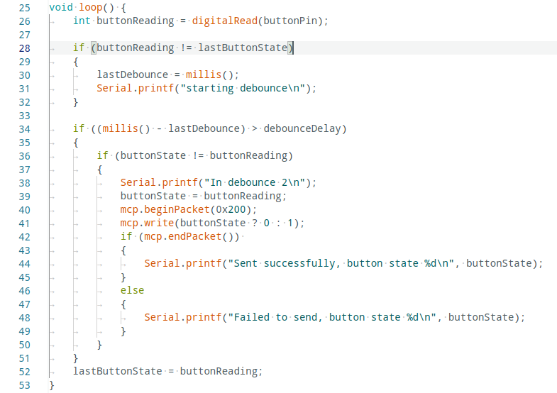
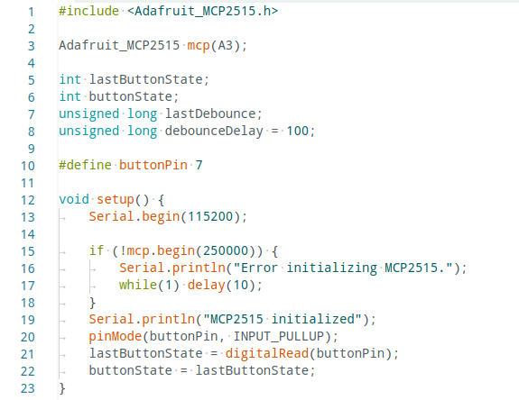
Doorbell

Slide 17
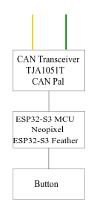
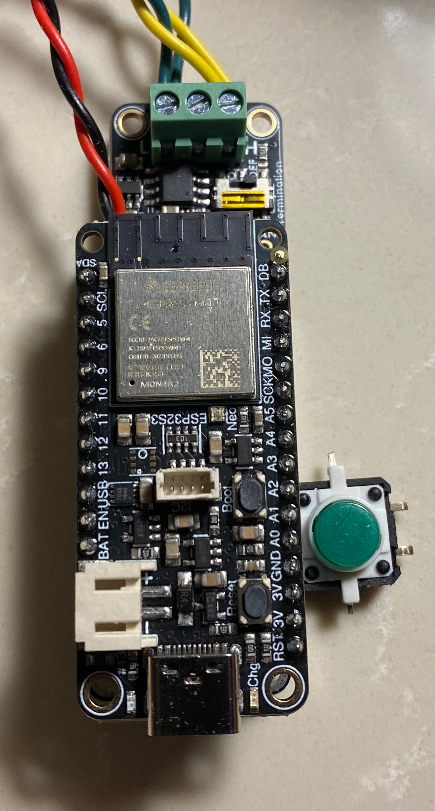
DOORMAT
Using Adafruit ESP32-S3 with Adafruit CAN Pal (just the transceiver) and CircuitPython

Slide 18
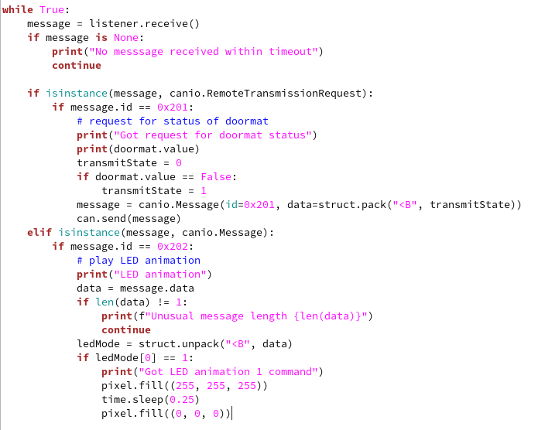
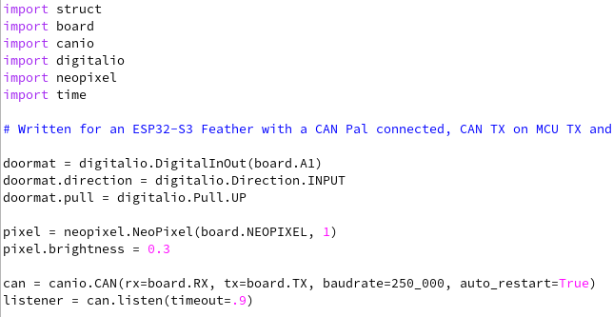
DOORMAT

Slide 19
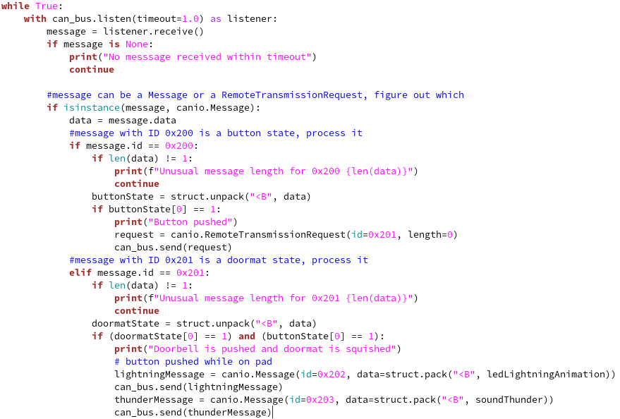
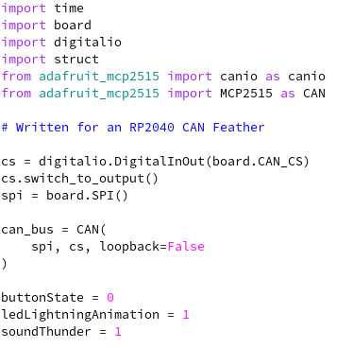
Controller
Adafruit RP2040 CAN Feather, using CircuitPython

Slide 20
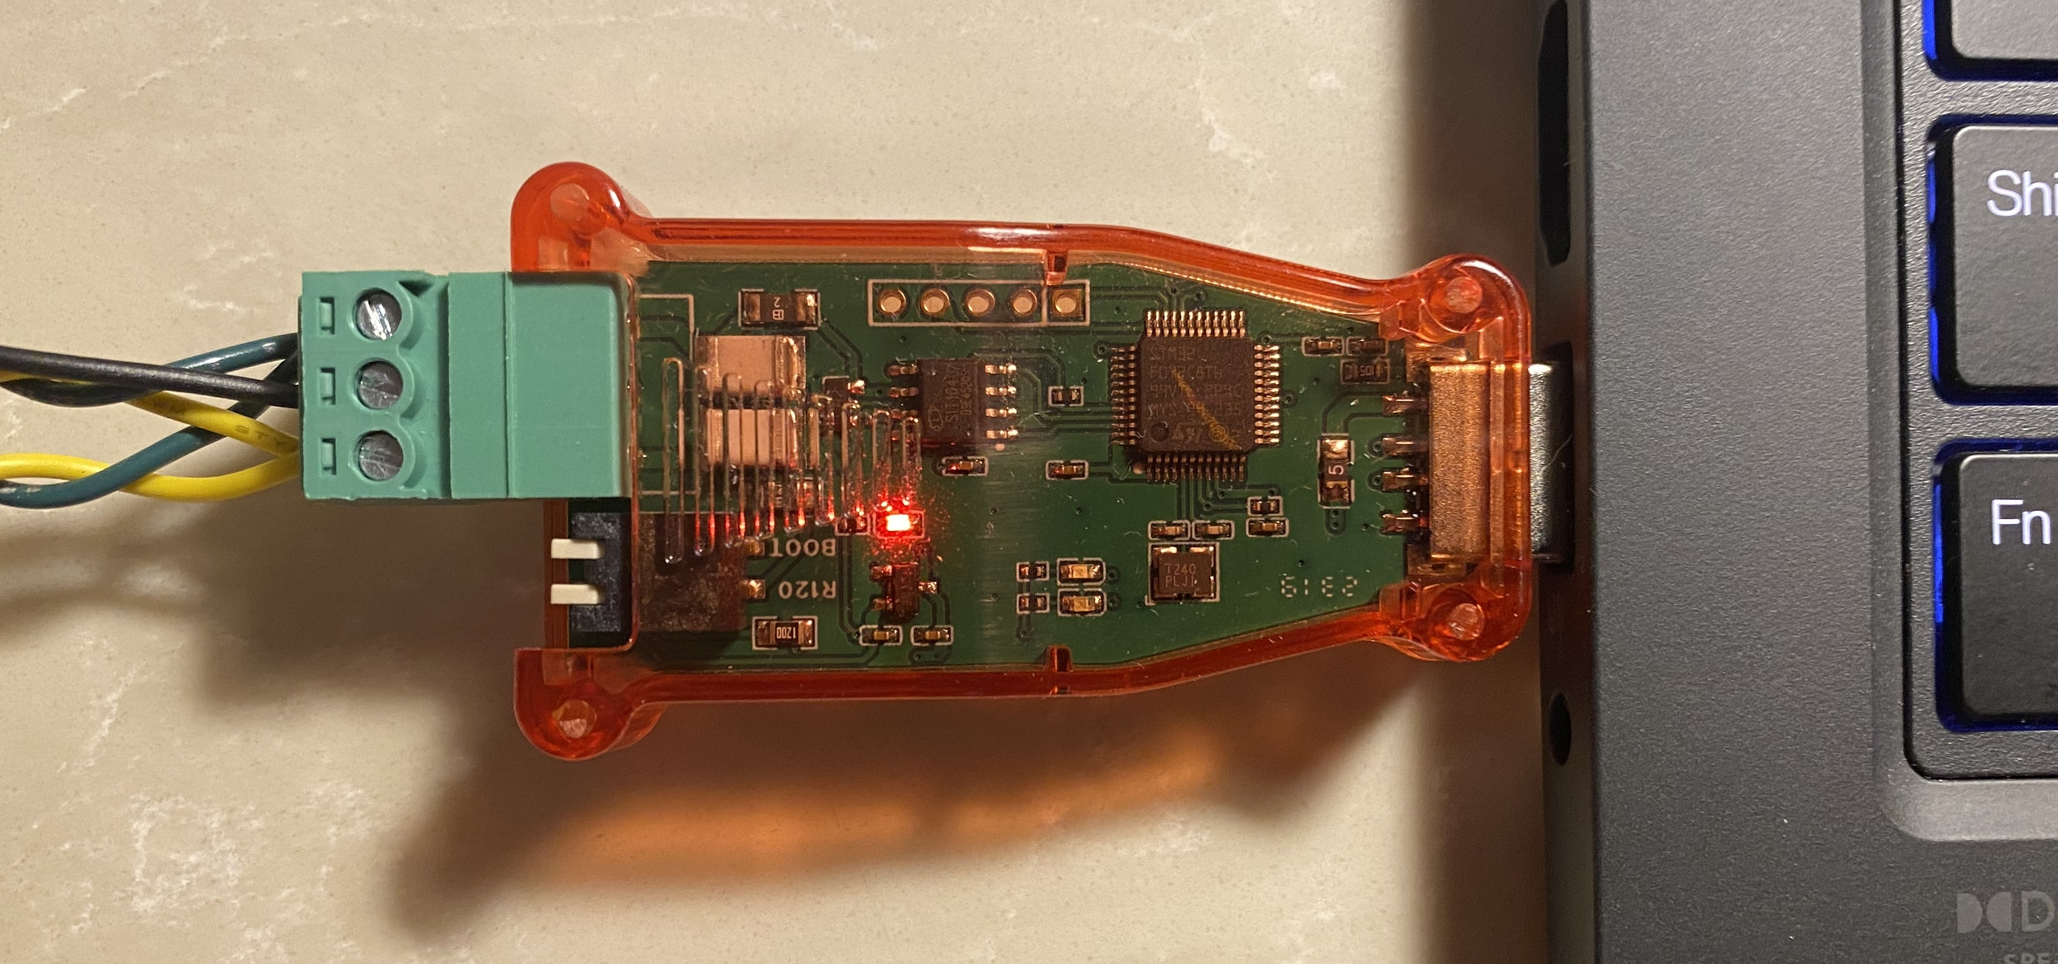
Linux set up
Plug in USB CAN dongle
Run as root: ip link set can0 type can bitrate 250000
Run in a terminal: candump can0
Send a packet: cansend can0 200#01

Slide 21
Demo Video
Put demo video here

